Slide 1

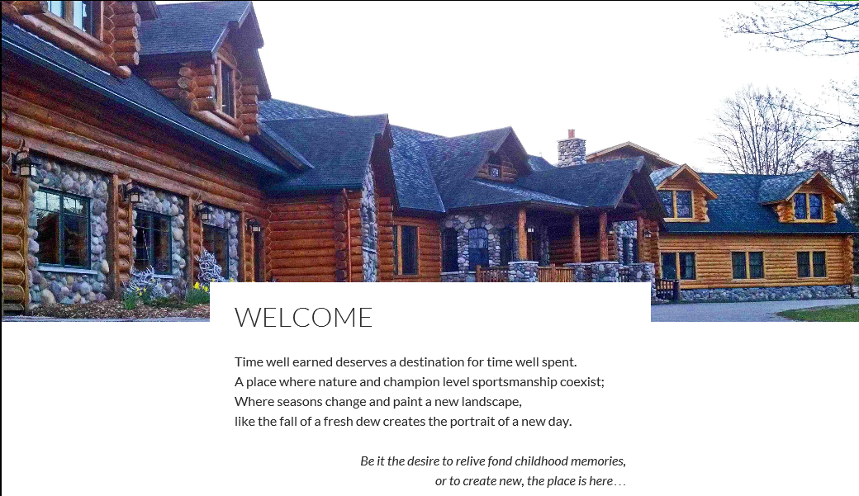

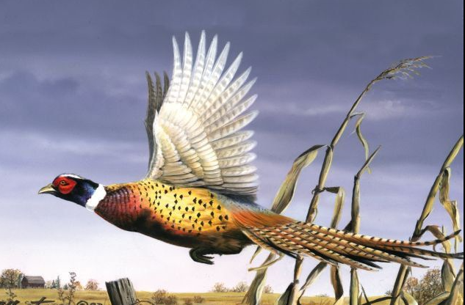
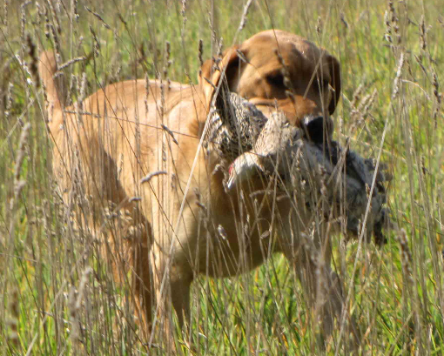
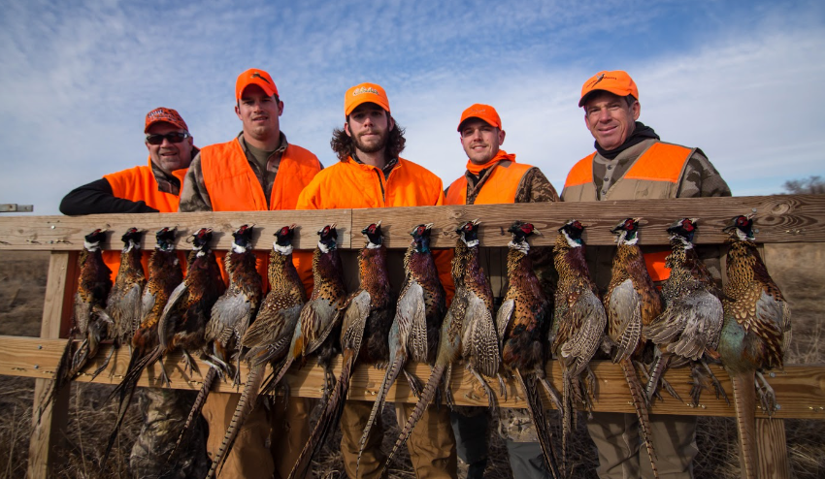
Muy Grande Ranch and Resort
Enjoy a Pheasant Hunt sponsored by Camp Liberty and Muy Grande Ranch and Resort for Purple Heart and Invisible Wounded Veterans
Date: August 27 – 30, 2015 = Available for 3 Veterans*
Date: September 4 - 6, 2015 = Available for 15 Veterans (This event is postponed due to pheasant availability – it will be reschedule!!! – Please sign up and you will be contacted)
*Includes 3 night stay, food and a pheasant hunt. Birds, ammo and shotguns will be provided. Bring your own shotgun if you want.
Visit camp-liberty.org for bonus details and registration

